Slide 1

HASKELL! (by Thomas)

Slide 2

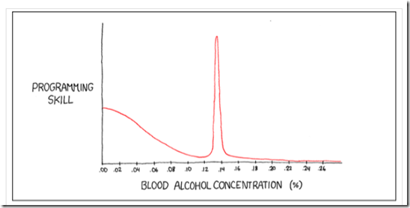
Haskell
https://xkcd.com/323/

Slide 3
¿Que es Haskell?
Lazy, pure functional programming language
Only lazy language that's still around
WHY?!?!?!?!?!
Types!
Correctness!
ONLY IMPORTANT THING EVER
Fast & WRONG < slow & RIGHT
Most wrong programs give you wrong answers slowly

Slide 4
Dysfunctional programming???
Math theorem:
a^2 + b^2 = c^2
But what if a isn't a number?? #cproblems
A function = no side effects
What happens if the pythagorean theorem connects to the internet?
C doesn't have functions
Procedures, please

Slide 5
:) Time for some code!

Slide 6
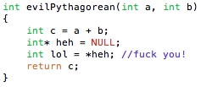
Haskell won't crash your computer
Imperative languages play dirty
Access a file, overwrite global variables, connect to the internet
Total anarchy

Slide 7
“Psh, I'm the master of state”
How much state is there?
AKA how much stuff can C/C++/Java destroy?
A bunch of memory…
A lot of disk space…
The entire internet…
Time
Cannot believe you all trust library authors not to break these things

Slide 8
Purity
Pure = no side effects
Impure = has side effects
IO type
Main
Math functions are pure, close() is not
What if the file is on remote storage?
What if the file doesn't exist?

Slide 9
IO
IO infects everything
IO a
An action that returns a
IO ()
Basically void
IO code can unwrap IO values and pass them to pure code
putStrLn :: String → IO ()
readFile :: FilePath → IO String

Slide 10
IO
Why is this “unsafe”?
unsafePerformIO :: IO a → a
Used pretty exclusively for interfacing with C
Example: regex lib

Slide 11
Laziness
At the end of the day we want a result
The main function: main :: IO ()
A big chain of IO functions
Forcing a value = actually doing work
Walk through main until the end

Slide 12
Consequences of Laziness
Unemployment
Infinite lists
So long as you eventually use <infinity
Must be pure
If you never know when or if something will run, have to parameterize everything
Somewhat hard transition to writing idiomatic Haskell
Can force strictness if you want
e.g. read from disk
Doesn't propagate up!

Slide 13
Laziness example

Slide 14
Time for some syntax

Slide 15
Type Signatures
Type inference
Like Java Generics on steroids
Compiler infers most general type
Can write your own type signature whenever you want to restrict domain
Can write type signatures wherever you want
foo :: some_input → another_input → some_output

Slide 16
Data Types
(Time to show you the example!)

Slide 17

Pattern Matching
Do something for each constructor
Unwraps values
Underscore matches anything
Suit doesn't matter for face cards
Anything that isn't a Jack, Queen, or King isn't a face card

Slide 18
Working with Lists
No loops
Loops are imperative: do this x many times
Only recursion
Map and fold are the workhorses
map :: (a → b) → [a] → [b]
Do something for every item in the list
foldr :: (a → b → b) → b → a → b
Woah!
Will become clear
Used to accumulate a value

Slide 19
map and fold examples

Slide 20
Practical Stuff
But thomas, I wanna go fas!
Memoization optimization
Never run a pure function twice
Lots of compiler optimizations
Compiler knows WAY more about your program

Slide 21
Real World Examples
Huge list: https://wiki.haskell.org/Haskell_in_industry
Pugs, perl6 interpreter
Quickcheck
https://www.fpcomplete.com/wp-content/uploads/2013/05/Bump%20case%20study.pdf
Purity is WAY better for concurrency!

Slide 22
Pandoc!
Document converter and library
Document conversion = super functional
SO MANY FORMATS!
Awesome
http://pandoc.org/diagram.jpg

Slide 23
Why should I care?
Haskell drastically changes how you think about programming
More aware of side effects = less bugs
Worth learning even if you never write anything meaningful in it!
I haven't even covered anything crazy (monads, functors, etc.)
IT WILL BLOW YOUR MIND!

